Slide 1
Akshita Gadiparthi
British Airways Customer Reviews Analysis

Slide 2
INTRODUCTION
To analyze the customer experience of traveling with British Airways, we focus on evaluating the comfort and convenience provided by the airline.
This involves assessing aspects such as the seating arrangement, in-flight ambiance, and the quality of service offered by the crew. By examining customer reviews and ratings, we can identify the airline's strengths and pinpoint areas needing improvement like
comfort and seating,in-flight experience,service quality,areas for improvement.

Slide 3
OBJECTIVES
Collection of customer reviews from multiple platforms (e.g., Trustpilot, Google Reviews, social media).
Categorization of reviews into various aspects such as customer service, in-flight experience, punctuality, and value for money.
To provide actionable insights for British Airways to enhance customer experience.
To identify common customer pain points and areas of excellence.

Slide 4
Data Scraping of some services
Comfort seating
In-flight experience
Service quality
Call service

Slide 5
Data Scraping
Comfort and seating
Rating: 3.5
Service Quality
Rating: 5.0
In-flight Experience
Rating: 4.0
Call Service
Rating: 4.5

Slide 6
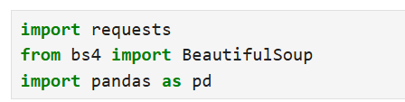
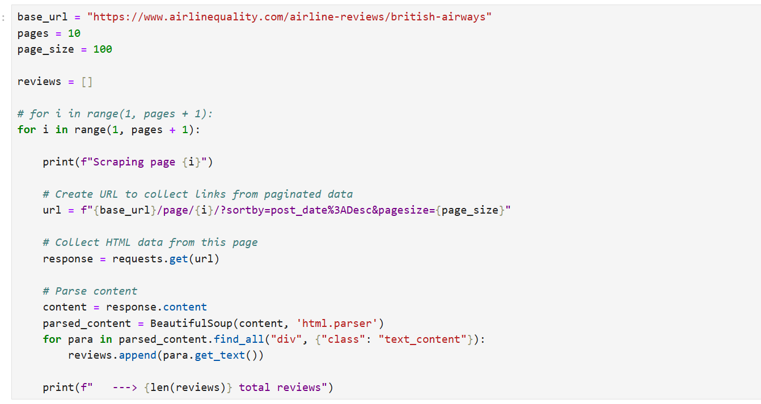
Data scraping through python

Slide 7


Slide 8
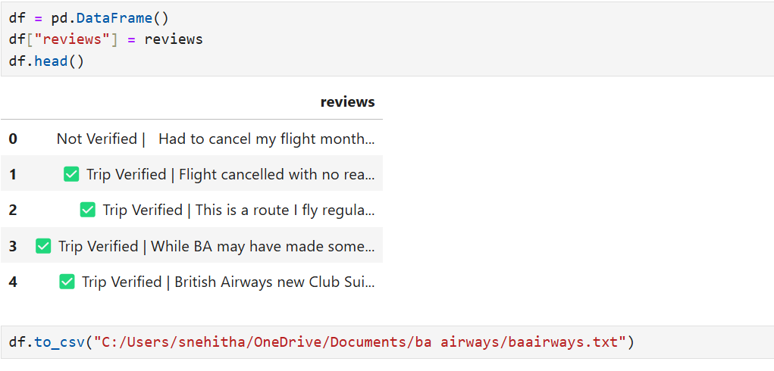

Slide 9
Areas to work by analyzing customer reviews
1. Communication and navigation information to the customers have to be highly increased as customers are facing a lot of problems by services given by airlines mainly in connecting flights.
2. Complaint about old business class seatings.
3. Economy class facilities must be increased as very low ratings is given over all services like legroom,seat comfort,staff service,food and beverages,inflight entertainment,etc.
4. For business class ground service rating is low.

Slide 10
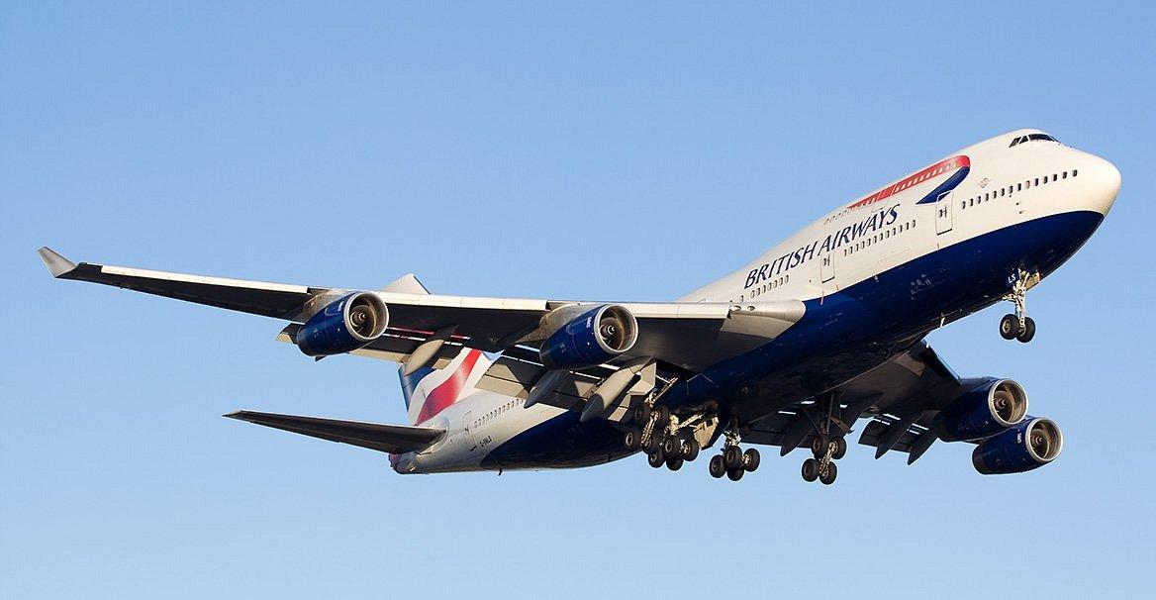
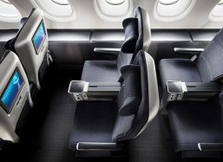
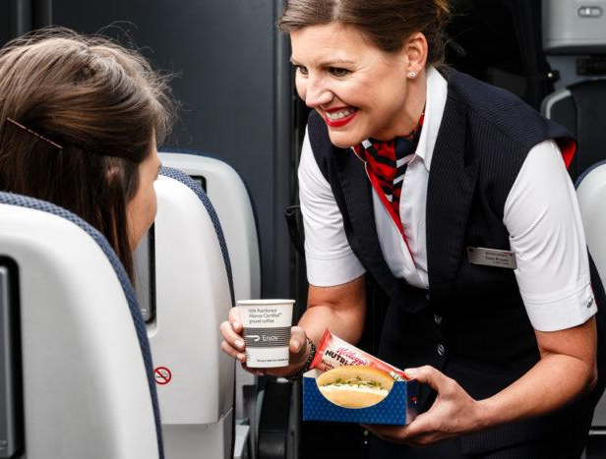
Areas of Improvement
Identifying recurring themes in negative reviews, such as discomfort in economy class, delays, or poor customer service.
Providing targeted recommendations to address these issues, such as upgrading seats, enhancing crew training, or improving in-flight amenities.

Slide 11
Conclusion
1.By acting on these insights, British Airways can enhance the travel experience for passengers, leading to increased customer satisfaction and loyalty. This, in turn, can result in higher profitability and a stronger competitive position in the airline industry.
2. By continuously improving and adapting based on customer feedback, British Airways can attract more passengers, increase market share, and maintain its reputation as a preferred airline for travelers seeking comfort and excellent service.

